Slide 1
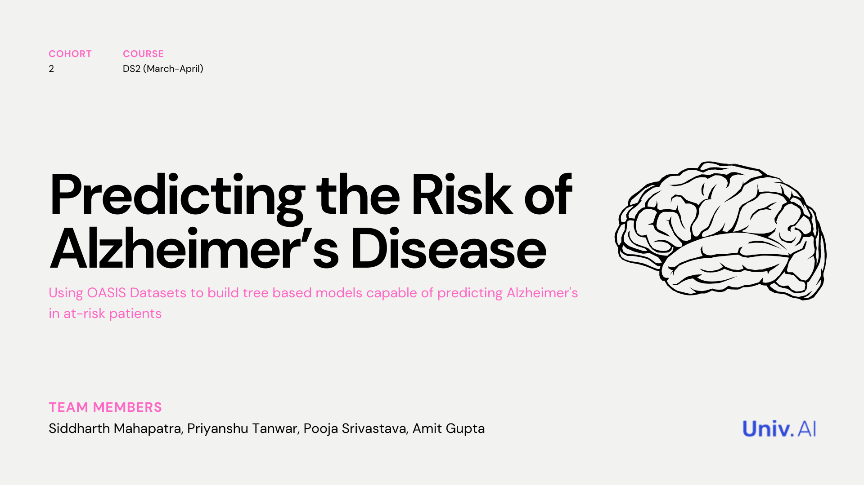

Slide 2
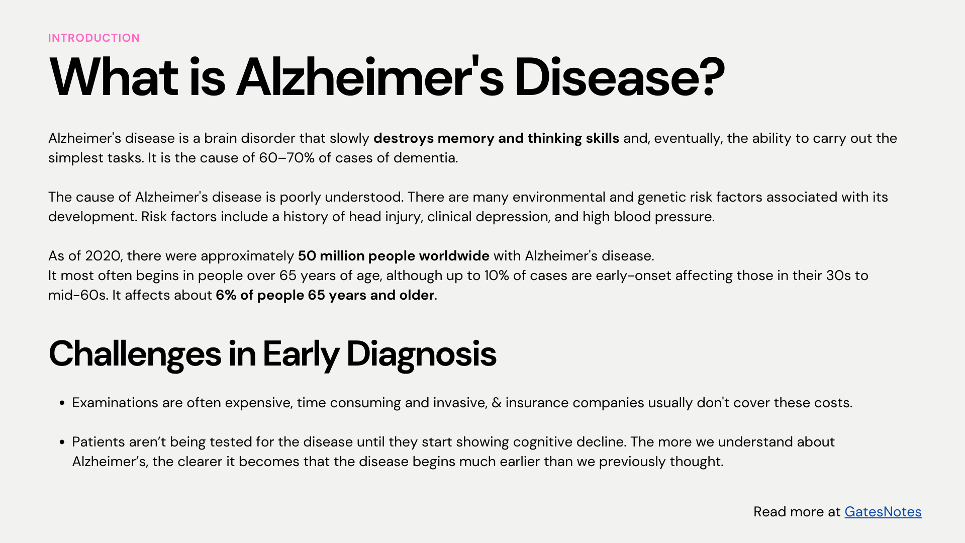

Slide 3
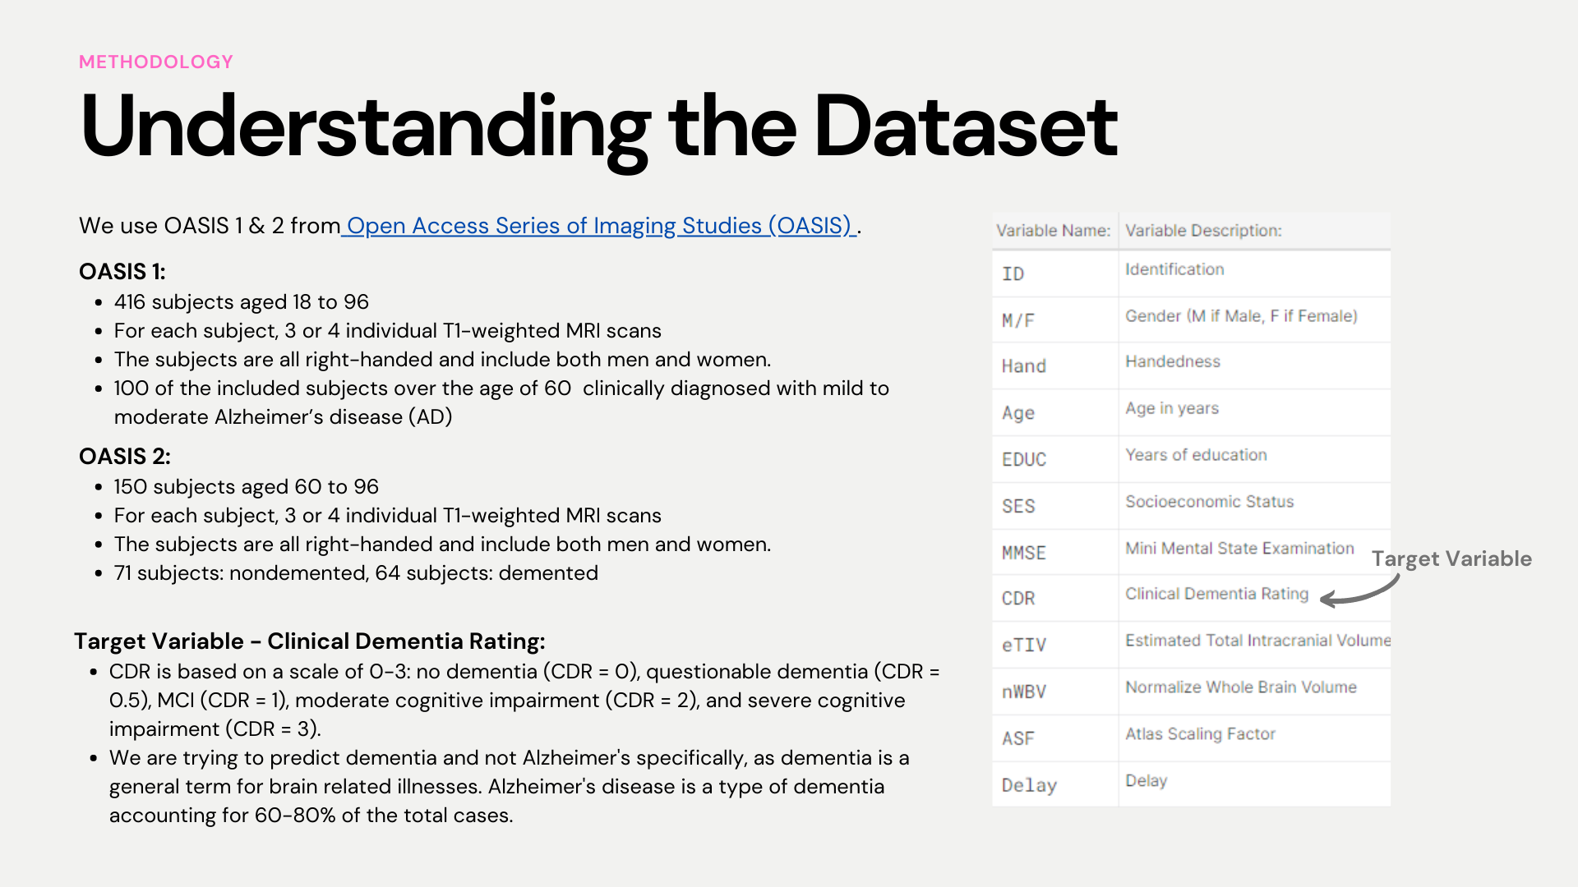

Slide 4
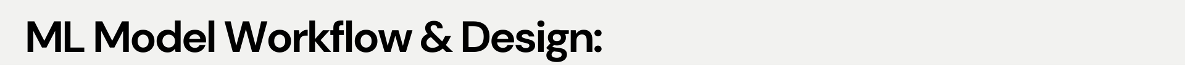
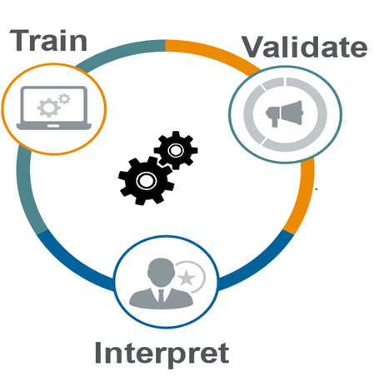
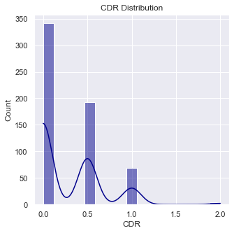
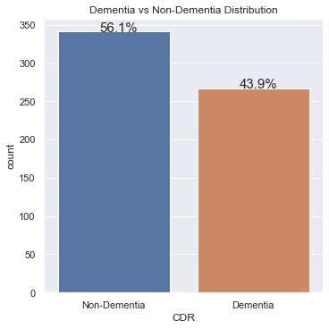
ML MODEL WORKFLOW & DESIGN
1
Data Collection & Set Up
2
Feature Engineering & EDA
3
ML Models & Interpretability
OASIS 1
Sample: 436
OASIS 2
Sample: 373
Missing Value Treatment
Removing features
6 Machine Learning Models tested; Random Forest finally chosen based on best Test Accuracy
Logistic Regression - Base Model
Decision Tree
Bagging Classifier
Random Forest – Best Model
Adaboost Gradient
Boosting Classifier
Combining both datasets
Removed 201 entries where Clinical Dementia Rating(CDR) is missing. Rationale: Imputation not done as CDR is the dependent variable
Mean Imputation done for Socio Economic Status (SES) & Mini Mental State Examination.
Handedness: Since all subjects are right-handed, we removed this feature
Delay: removed as not present in OASIS 1 dataset
Each Model optimized for hyperparameters
Final Data
Sample: 809
Source: Open Access Series of Imaging Studies
80% of the data (training data) is used by model to learn the relationship between the input and output
10-Fold Cross-Validation done
20% of the remaining data (validation data) used to evaluate model performance
Sample above is at MRI Sessions level
OASIS-1: Cross-sectional MRI Data in Young, Middle Aged, Nondemented and Demented Older Adults. This set consists of a cross-sectional collection of 416 subjects aged 18 to 96. For each subject, 3 or 4 individual T1-weighted MRI scans obtained in single scan sessions are included for a total of 436 imaging sessions.
OASIS-2: Longitudinal MRI Data in Nondemented and Demented Older Adults. This set consists of a longitudinal collection of 150 subjects aged 60 to 96. Each subject was scanned on two or more visits, separated by at least one year for a total of 373 imaging sessions.
Final Sample Size after missing value treatment : 608
Creating Final Dependent Variable (CDR)
Combining Clinical Dementia Rating 0.5,1 and 2 for identifying subjects with Dementia and 0 as Non-Dementia
0.5=Very Mild Dementia, 1=Mild Dementia, 2=Moderate Dementia
0 = Non-Dementia
Explainer interactive Dashboard created which enables:
quickly inspect the workings and performance of the final model
explains individual predictions of final model
Interactive Dashboard Features includes:
Confusion Matrix & ROC AUC plot - What happens when you change cutoff probability?
Shapley Values - What is the contributions of each feature at a global level?
Shapley Dependence Plot – What is the relationship b/w feature value & Shapley Value?
Individual Predictions – How each feature contributed to the individual predictions?
EDA
Exploratory Data Analysis done for each feature

Slide 5
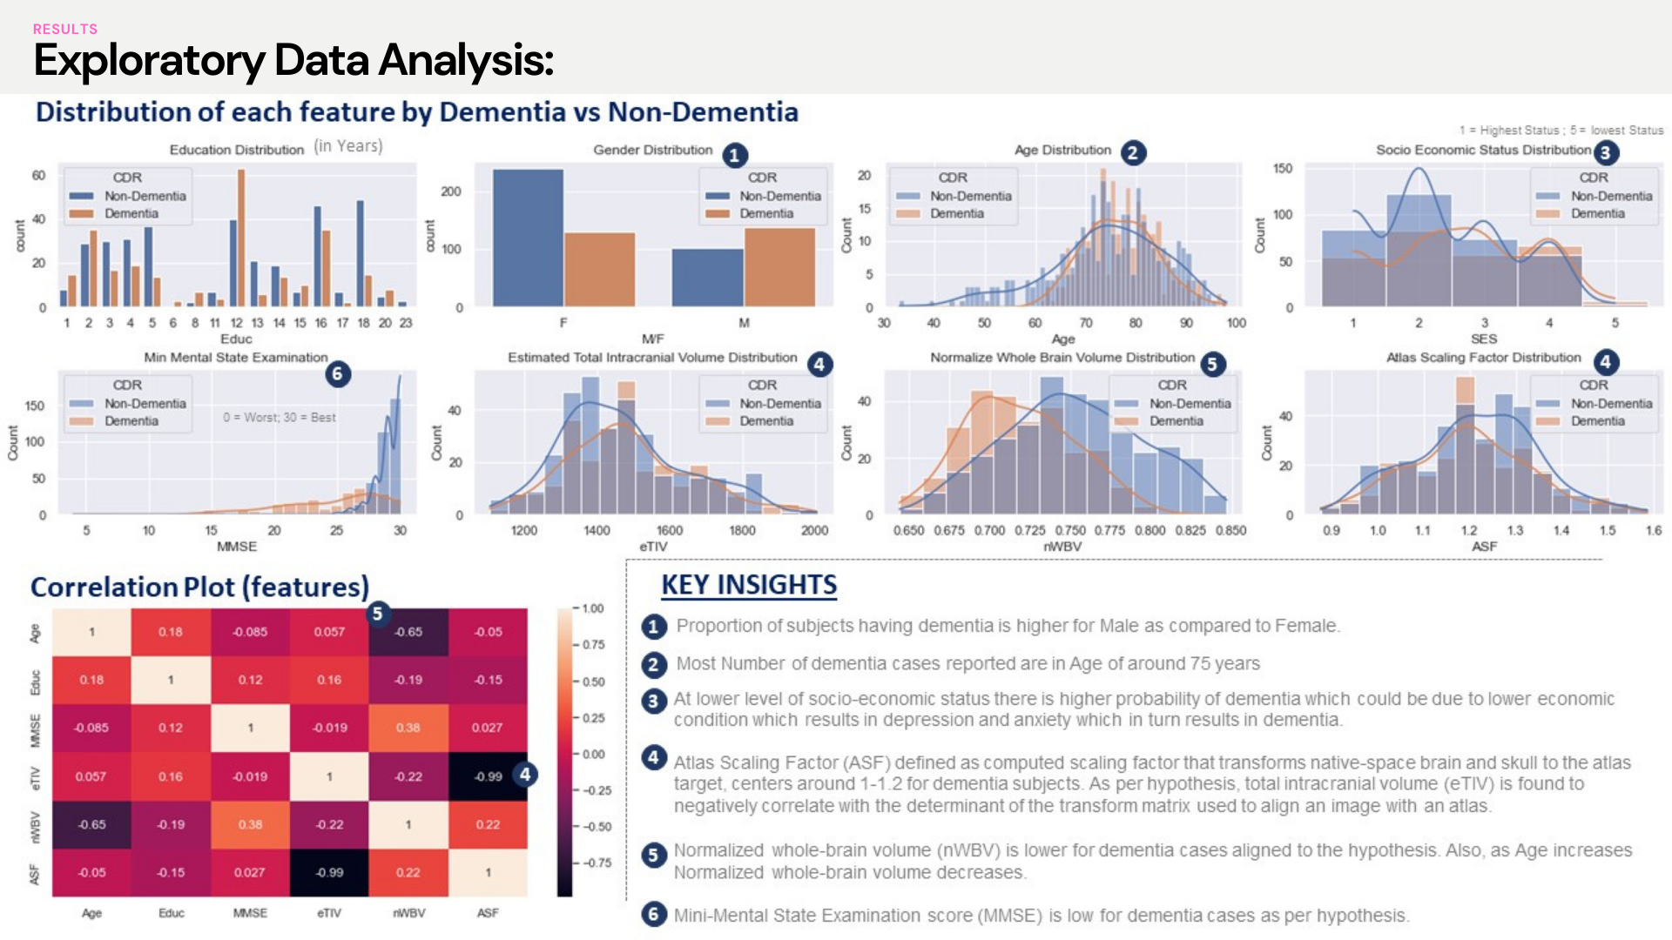
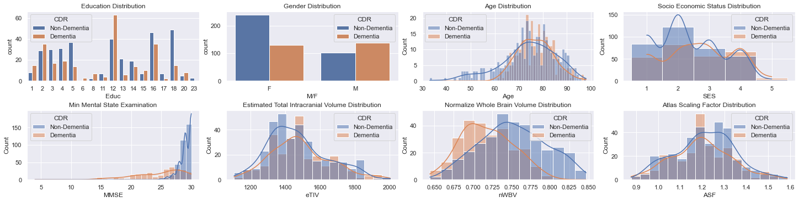
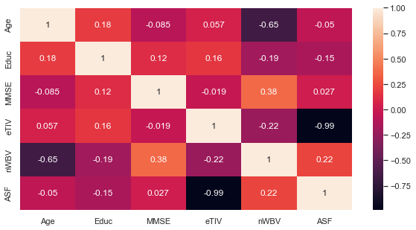
Exploratory Data Analysis
Distribution of each feature by Dementia vs Non-Dementia
(in Years)
1 = Highest Status ; 5 = lowest Status
1
2
3
6
4
5
4
0 = Worst; 30 = Best
Correlation Plot (features)
KEY INSIGHTS
5
1
Proportion of subjects having dementia is higher for Male as compared to Female.
2
Most Number of dementia cases reported are in Age of around 75 years
3
At lower level of socio-economic status there is higher probability of dementia which could be due to lower economic condition which results in depression and anxiety which in turn results in dementia.
4
4
Atlas Scaling Factor (ASF) defined as computed scaling factor that transforms native-space brain and skull to the atlas target, centers around 1-1.2 for dementia subjects. As per hypothesis, total intracranial volume (eTIV) is found to negatively correlate with the determinant of the transform matrix used to align an image with an atlas.
Normalized whole-brain volume (nWBV) is lower for dementia cases aligned to the hypothesis. Also, as Age increases Normalized whole-brain volume decreases.
Mini-Mental State Examination score (MMSE) is low for dementia cases as per hypothesis.
5
6

Slide 6
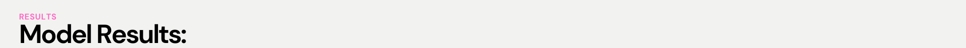
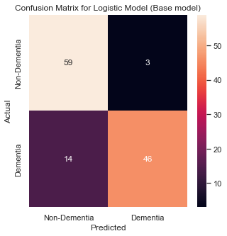
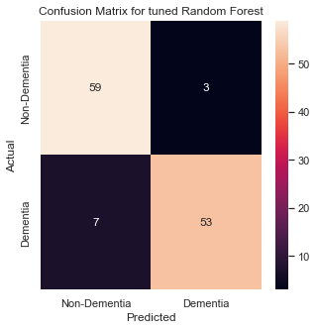
Model Results
6 Machine Learning Models tested (CV=10); Random Forest finally chosen based on best Test Accuracy
Base Model
Best Model
Train vs Test Accuracy
Best* Hyperparameters
-
C: 1.0
Penalty:'l1'
Solver: liblinear
Criterion: Gini
Max_depth:8
Min_samples_split: 2
N_Estimators:60
Max_Depth: 17
Max_features:2
N_Estimators:300
’
N_Estimators:100
Learning Rate: 0.0001
N_Estimators:500
Learning Rate: 1
Confusion Matrix- Base Model (Logistic)
Confusion Matrix- Best Model (Random Forest)
Weighted Recall: 86%
Weighted Precision: 87%
Weighted Recall: 92%
Weighted Precision: 92%
Recall for Dementia class is only 77%
Recall for Dementia class increases to 88%

Slide 7
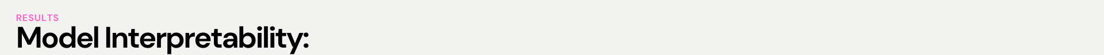
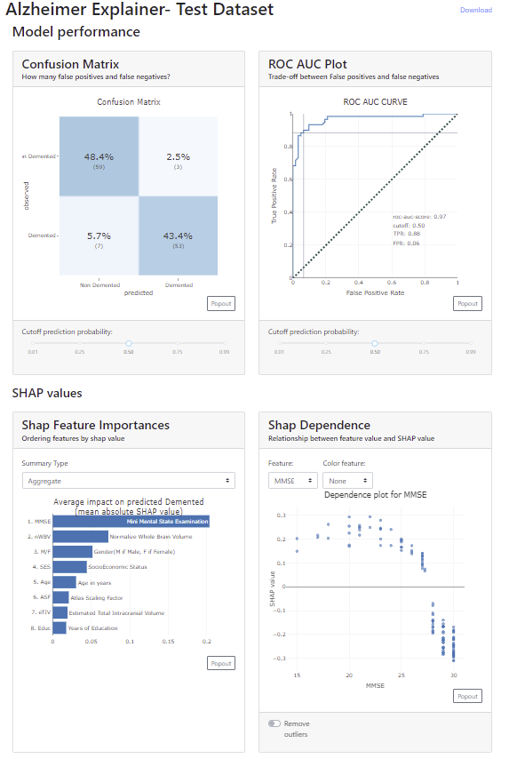
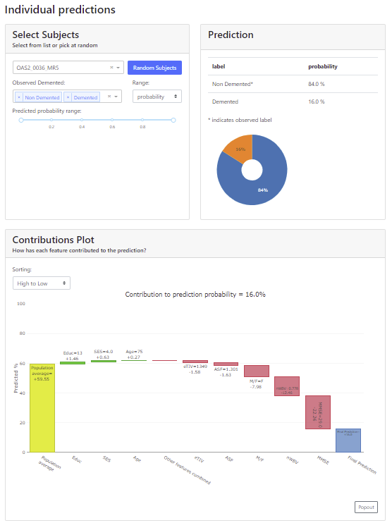
Explainer Interactive Dashboard created for model transparency & Interpretability
A
D
Confusion Matrix & ROC AUC plot
A
2
1
Change the probability cutoff slider to see changes in Model Performance
B
Shapley Values : Overall Feature Importance using SHAP values
C
Shapley Dependence Plot : Change the features to see the interaction b/w features & SHAP values
1
D
Individual Predictions : Shows how each feature contributed to the individual predictions?
B
C
2
Select any subject from the test data and see their prediction & how each feature contributed to that prediction

Slide 8
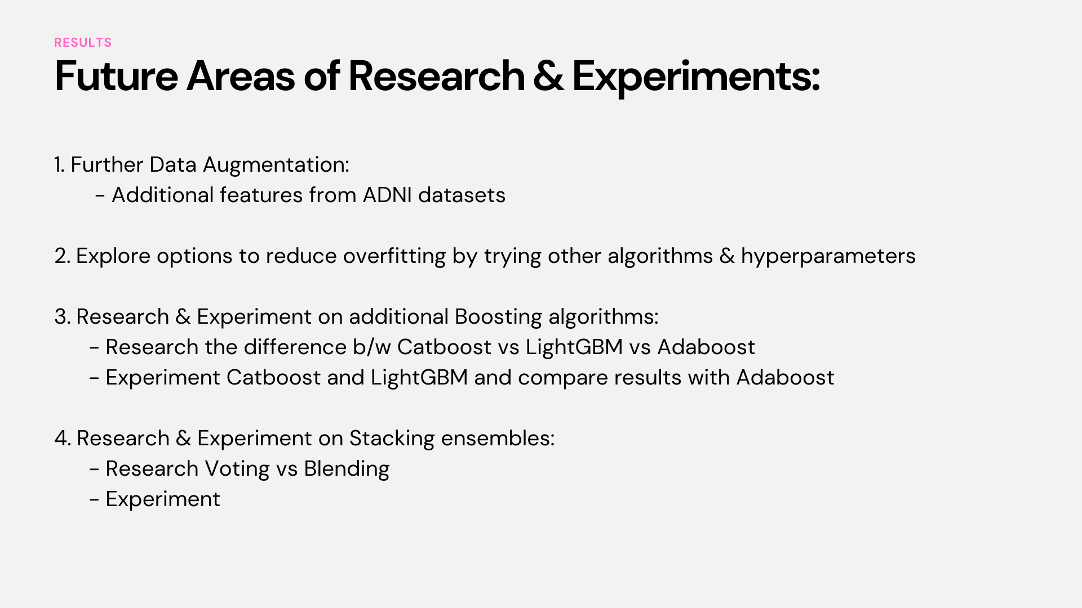
Future Areas of Research & Experiments
Further Data Augmentation:
Additional features from ADNI datasets
Explore options to reduce overfitting by trying other algorithms & hyperparameters
Research & Experiment on additional Boosting algorithms:
Research the difference b/w Catboost vs LightGBM vs Adaboost
Experiment Catboost and LightGBM and compare results with Adaboost
Research & Experiment on Stacking ensembles:
Research Voting vs Blending
Experiment

